Slide 1
Topic Modeling using Natural Language Processing
Available news and information is often stovepiped into a handful of sources that I see daily
Given a set of documents, employ a mix of supervised and unsupervised learning to first model the topics within the corpus of documents. Then train a model using Latent Dirichlet Allocation to classify the body into a defined set of topics, which can be used to label to new documents as they are introduced into the model.
Topic discovery
Tagging
Why

Slide 2
Approach
Build database using an API web scraper called NewsAPI
Indexes articles from over 30,000 worldwide sources
Typically, NewsAPI is used to answer questions such as
What top stories is the NY Times running right now?
What new articles were published about the next iPhone today?
Has my company or product been mentioned or reviewed by any blogs recently?
With NewsAPI metadata, download article content of a specific theme
For this project I scraped articles mentioning “Deep Learning” from Jan-April 2018
I loaded article content into various NLP models, including Latent Semantic Analysis (LSI or LSA) and Latent Dirichlet Allocation (LDA) for topic modeling.
Visualized the distribution of topics on a scatter plot using tableau

Slide 3
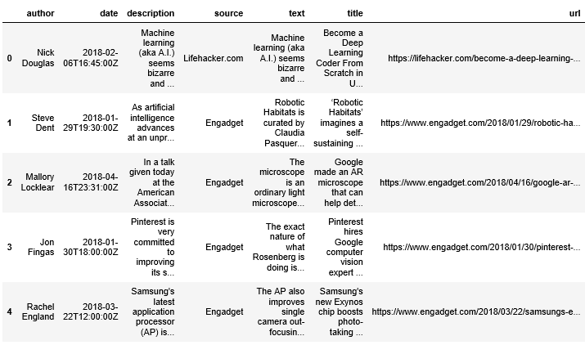

Slide 4
Documents were transformed into a term matrix (Bag of words) and vectors using TFIDF vectorizer.
LDA
(0, '0.019*"▸" + 0.019*"cloud" + 0.018*"new" + 0.014*"dxworldexpo" + 0.013*"cloudexpo" + 0.012*"opportunity" + 0.011*"conference" + 0.010*"enterprise" + 0.010*"york" + 0.009*"technology“’)
(1, '0.009*"data" + 0.008*"ai" + 0.007*"learning" + 0.005*"technology" + 0.004*"machine" + 0.004*"new" + 0.004*"company" + 0.004*"system" + 0.004*"one" + 0.004*"deep“’),
(2, '0.017*"2018" + 0.016*"cloud" + 0.016*"new" + 0.011*"read" + 0.011*"apr" + 0.011*"edt" + 0.009*"york" + 0.008*"business" + 0.008*"22" + 0.008*"cloudexpo“’),
(3, '0.021*"data" + 0.016*"cloud" + 0.012*"2018" + 0.010*"big" + 0.010*"business" + 0.009*"read" + 0.009*"apr" + 0.009*"edt" + 0.009*"iot" + 0.008*"product“’),
(4, '0.013*"model" + 0.008*"learning" + 0.008*"image" + 0.007*"data" + 0.006*"deep" + 0.005*"training" + 0.005*"1" + 0.005*"network" + 0.005*"using" + 0.005*"python"')]
LSA
[(0, '0.309*"cloud" + 0.309*"data" + 0.251*"2018" + 0.217*"new" + 0.172*"read" + 0.170*"edt" + 0.170*"apr" + 0.168*"business" + 0.141*"cloudexpo" + 0.140*"product“’),
(1, '0.367*"data" + 0.208*"model" + -0.194*"dxworldexpo" + -0.187*"cloudexpo" + -0.164*"cloud" + -0.158*"new" + 0.144*"learning" + -0.128*"▸" + -0.126*"devops" + 0.122*"webrtc“’),
(2, '0.245*"model" + 0.228*"learning" + 0.147*"training" + 0.141*"▸" + 0.125*"new" + 0.124*"ai" + 0.123*"image" + -0.122*"webrtc" + 0.112*"using" + 0.112*"deep“’),
(3, '-0.241*"22" + 0.228*"data" + 0.204*"21" + 0.193*"big" + 0.162*"digital" + -0.160*"new" + -0.135*"microservices" + 0.133*"enterprise" + -0.131*"need" + -0.130*"devops“’),
(4, '-0.358*"▸" + -0.190*"opportunity" + 0.189*"model" + -0.156*"speaking" + -0.141*"conference" + -0.139*"world" + -0.131*"session" + -0.131*"sponsorship" + 0.129*"training" + 0.126*"read"')]

Slide 5
LDA Topic Model (5 Topics)
Topic #0: ensure life code email user ability problems 100 enable learning large number machine learning vision faster tools blog image year ve
Topic #1: mxnet download file python install learning tensorflow deep learn deep learning model platform https models gpu training code source project neural
Topic #2: ai learning data deep said deep learning new machine machine learning technology intelligence nvidia time research artificial using like artificial intelligence company use
Topic #3: cloud apr edt reads edt 2018 reads data apr 22 22 2018 22 cloudexpo business new york york new iot webrtc digital big data transformation
Topic #4: cloud cloudexpo dxworldexpo devops sponsorship speaking opportunities new conference new york york expo dxworldexpo cloudexpo fintech email transformation email protected speaking opportunities protected slide

Slide 6
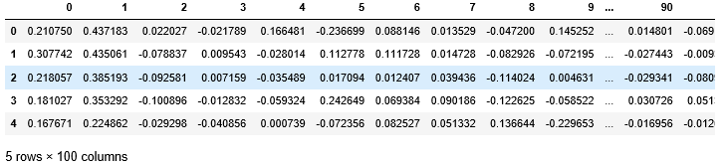
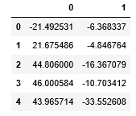
Visualizing Conceptual Landscape using LSA and Kmeans Clustering for Further Exploration
LSA reduced the term matrix to 100 dimensions
KMeans Clustered vectors using new dimensions, group them according to semantic similarity. (Assumes similar documents should use similar terms at higher numbers)
TSNE reduction to two dimensions for visualization
82523 unique terms (dimensions)
Column= Unique Term
LSA reduction:
100 dimensions
Row= Document (8506 total)
TSNE reduction: 2 dimensions!!!

Slide 7
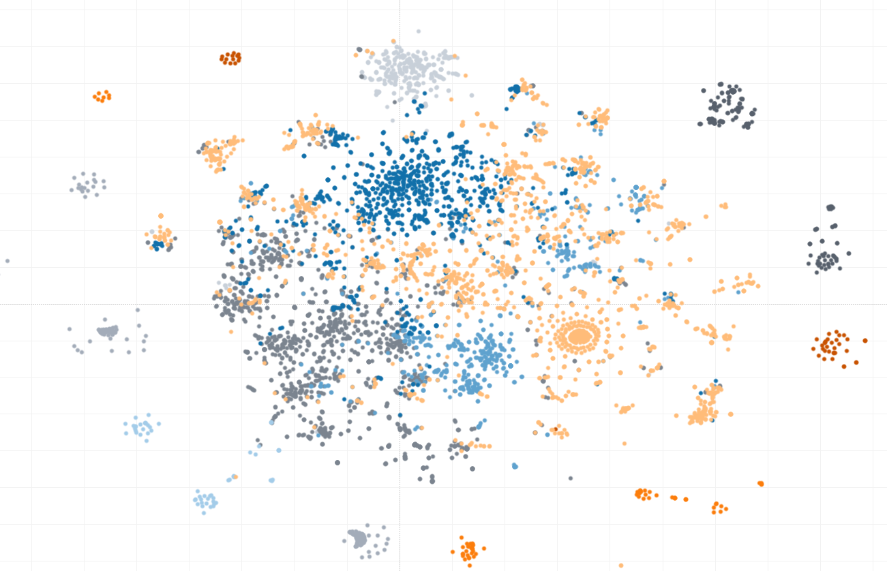
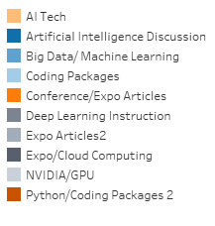

Slide 8
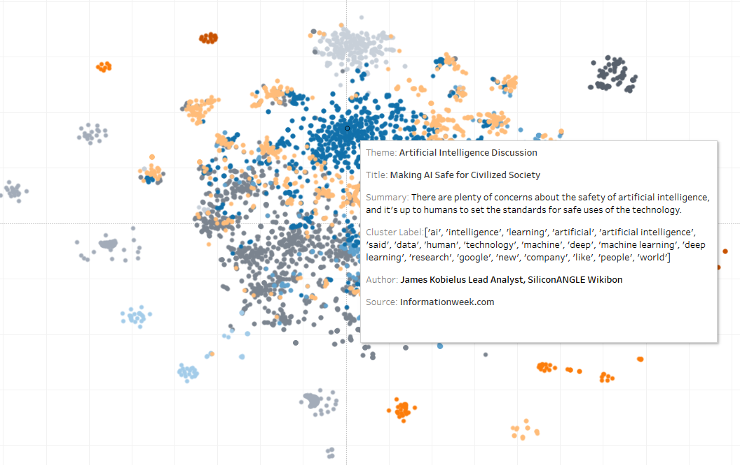

Slide 9
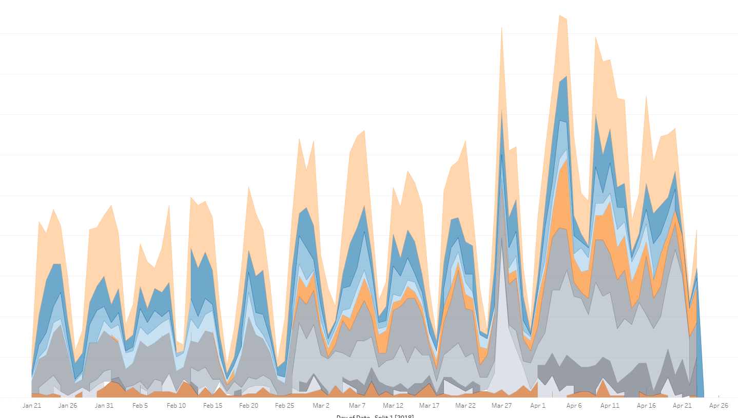
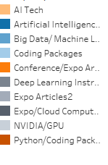

Slide 10
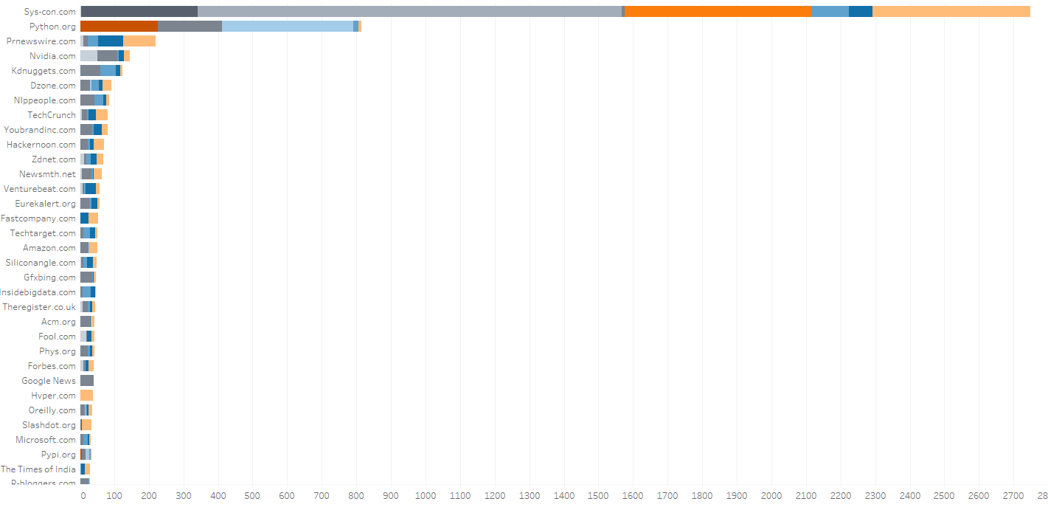

Slide 11
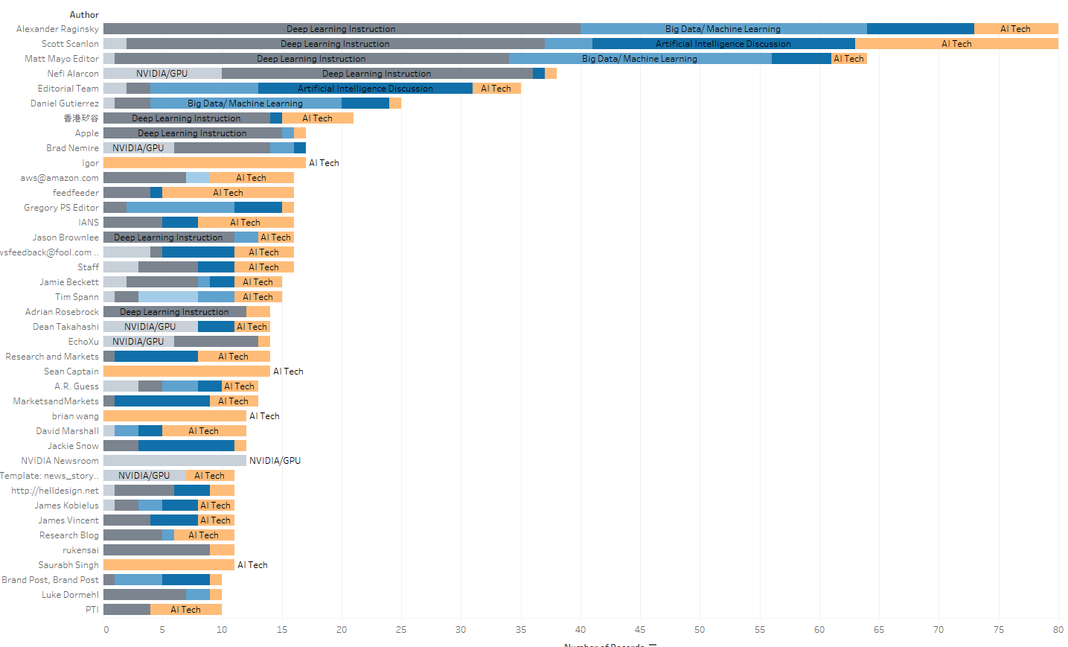

Slide 12
Conclusion
Latent semantic analysis (LSA) is an effective text mining method for informational retrieval.
Successfully able to build topic models whose clusters aligned well for the most part to the theme behind the article.
LSA works by reducing an original term-by-document matrix corpus of documents into a filtered term-document matrix through a procedure called singular value decomposition (SVD).
The cosine of the angle between two vectors can be used to measure the degree of similarity between two vectors.

Slide 13
Conclusion
Latent semantic analysis (LSA) is an effective text mining method for informational retrieval.
Successfully able to build topic models whose clusters aligned well for the most part to the theme behind the article.
LSA works by reducing an original term-by-document matrix corpus of documents into a filtered term-document matrix through a procedure called singular value decomposition (SVD).
The cosine of the angle between two vectors can be used to measure the degree of similarity between two vectors.

Slide 14
Density Based Clustering with DB scan, density of a cluster can determine level of effort behind a concept.

